Slide 1
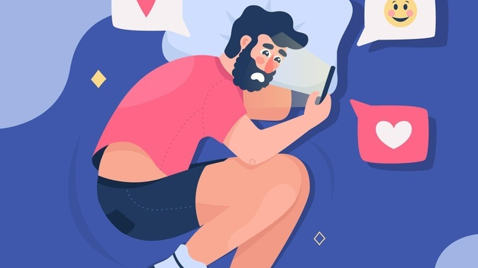
Get off the Gram and Get Your Life
A study on individuals who spend a lot of time on social media, specifically Instagram, observing and comparing themselves to others based off their content
Mikayla Hill
COM 4410
Professor Diggs
October 20th, 2021

Slide 2
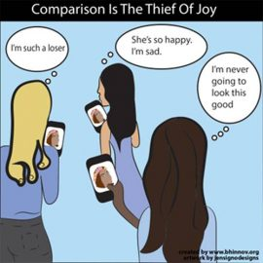
Purpose Statement
The purpose of this research is to investigate the correlation between high Instagram usage and social comparison.
To come to an understanding on why people compare their lives to others based off what they see on Instagram.

Slide 3
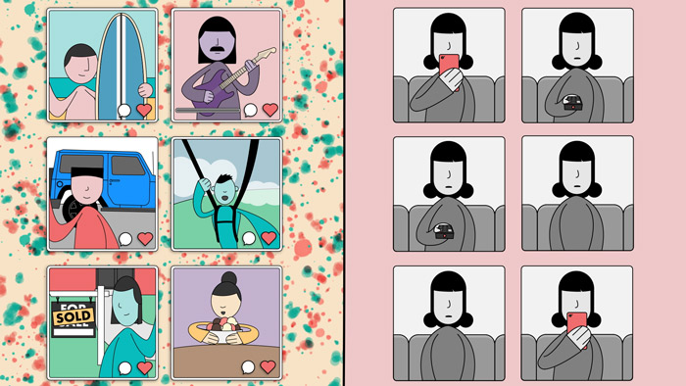
Why should this be studied?
Spending too much time keeping up with what others are doing on Instagram can have a negative impact on one's mood, self-esteem, and mental health. This leads to people comparing themselves to others and make assumptions about someone's life based off their social media page.
"Viewing positive images of attractive others can negatively affect one’s feelings, especially if those others— or the activities they’re engaging in—are relevant to one’s goals."
"These negative feelings can either be harnessed as inspiration (“I’m going to be fit or famous like them someday”) or, more commonly, be causes for negative self-evaluation (“I’ll never be that fit, good-looking, or famous”). (Jin, Ryu, & Muqaddam, 2018).
Social comparison made on SNSs (social networking service) is distinct from traditional forms of social comparison, not only because others selectively self-present images which are filtered through the affordances of the technology (Fox & Vendemia, 2016; Walther, 1996), but also because the technology allows end users to privately view other’s self-presentations at a time and place of their own choosing, even repeatedly if they wish. This gives individuals greater control over when and how they compare themselves to others, which can facilitate social comparisons that are self-serving, motivated, and selective.
Kohler, M. T., Turner, I. N., & Webster, G. D. (2021). Social comparison and state–trait dynamics: Viewing image-conscious Instagram accounts affects college students’ mood and anxiety. Psychology of Popular Media, 10(3), 340–349. https://doi.org/10.1037/ppm0000310
“I Look Up, I Look Down”: Assessing Antecedents and Consequents of Social Media Social Comparison. (2018). Conference Papers -- International Communication Association, 1–34.

Slide 4
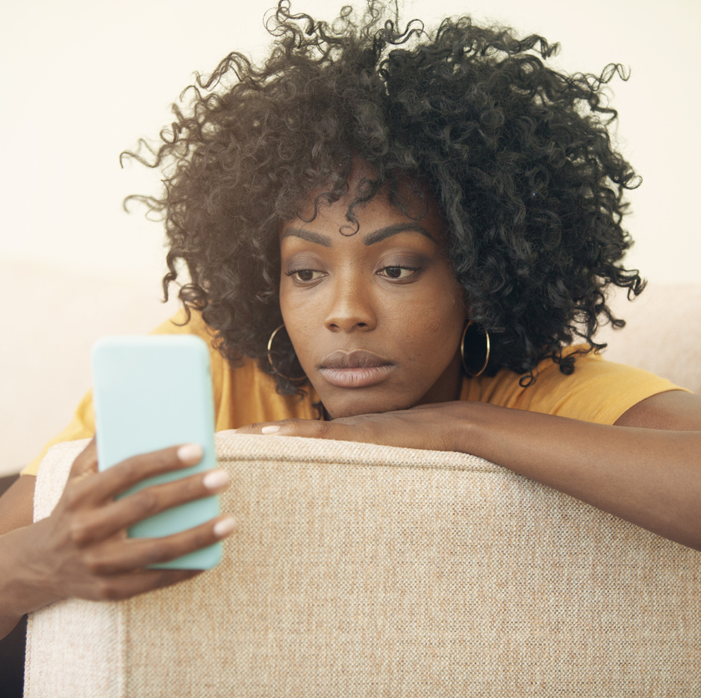
Problem
"social networks play a relevant role in the way individuals interact and present themselves to one another nowadays" (Kross et al., 2
The problem is that people comparing their lives to others is unhealthy and will have a negative impact on their mental health and could possibly cause envy. For example, if a person has a certain amount of wealth and posts about it, another person viewing it could may feel like their life is not as good as theirs, or that they should be doing more. It is also possible that people can become addicted to seeing what other people have going on in their lives and they won't be as focused on their own.
People are going to display what they what they want people to see. A person never really knows what someone has going on and shouldn't assume someone has a better life based off what they choose to share.
"On social media, individuals will predominantly encounter positive posts, as people tend to present the most positive sides of themselves and their lives on these platforms (Lin & Utz, 2015; Qiu, Lin, Leung, & Tov, 2012; Reinecke & Trepte, 2014)."
de Vries, D. A., Möller, A. M., Wieringa, M. S., Eigenraam, A. W., & Hamelink, K. (2017). Social Comparison as the Thief of Joy: Emotional Consequences of Viewing Strangers’ Instagram Posts. Media Psychology, 21(2), 222–245. https://doi.org/10.1080/15213269.2016.1267647

Slide 5
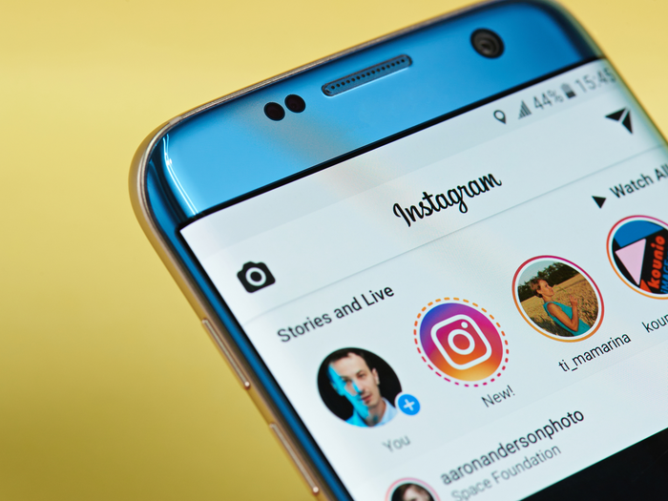
My Contribution
Most of the research I found, investigated people who viewed posts from strangers. I plan on investigating people who view posts of celebrities, influencers, and acquaintances. I will create a survey of questions asking how much time an individual spends on Instagram, who they view the most and what their relationship is to them, and if they ever feel jealous or compare themselves when viewing their content. Also, most of the research focused on the images on Instagram, and not the story feature the app has. I also plan on asking how often do individuals watch each other's stories and how does it affect their mood.

Slide 6
Independent Variables
Instagram
Social Media

Slide 7
Dependent Variables
Social Comparison
Self esteem
Self-Concept

Slide 8
Definitions
Instagram- "a social photo-sharing platform that is used primarily on mobile devices, especially smartphones." - Kohler, M. T., Turner, I. N., & Webster, G. D. (2021). Social comparison and state–trait dynamics: Viewing image-conscious Instagram accounts affects college students’ mood and anxiety. Psychology of Popular Media, 10(3), 340–349. https://doi.org/10.1037/ppm0000310
Self-esteem- consists of the attitude – positive or negative – towards self-concept (Rosenberg, Schooler, Schoenbach, & Rosenberg, 1995). -Fagundes, L. S., Marot, T. A., & Natividade, J. C. (2020). Use of Instagram, Social Comparison, and Personality as Predictors of Self-Esteem. Psico-USF, 25(4), 711–724. https://doi.org/10.1590/1413/82712020250410
Social Comparison- people coming to know themselves by evaluating their own attitudes and traits in comparison with others
Social Media- Computer based technology that facilitates the sharing of ideas, thoughts, and information through the building of virtual networks and communities.
Self-Concept- Self-concept refers to the sum of the individual’s beliefs about himself/herself, that is, his/her global self-perception (Heatherton & Wyland, 2003).

Slide 9
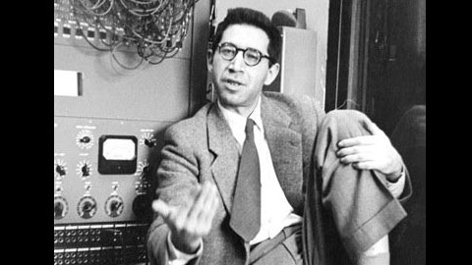
Social Comparison Theory
Idea that individuals determine their own social and personal worth based on how they stack up against others. - 1954, Leon Festinger

Slide 10
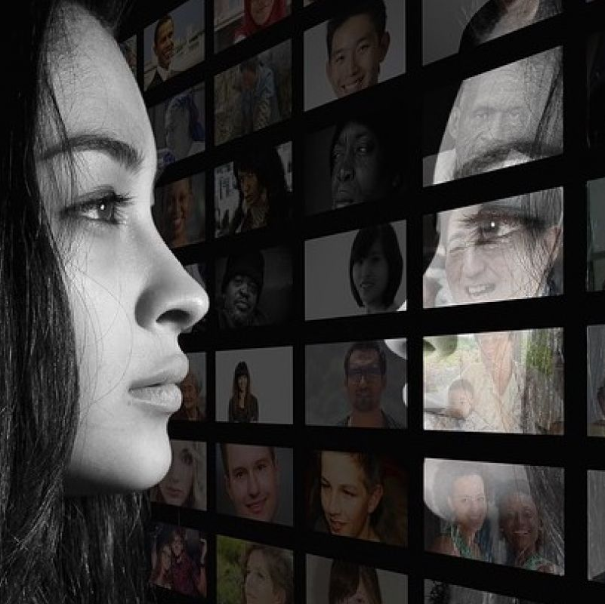
Hypothesis
H:^amount of time spent on Instagram^ social comparison

Slide 11
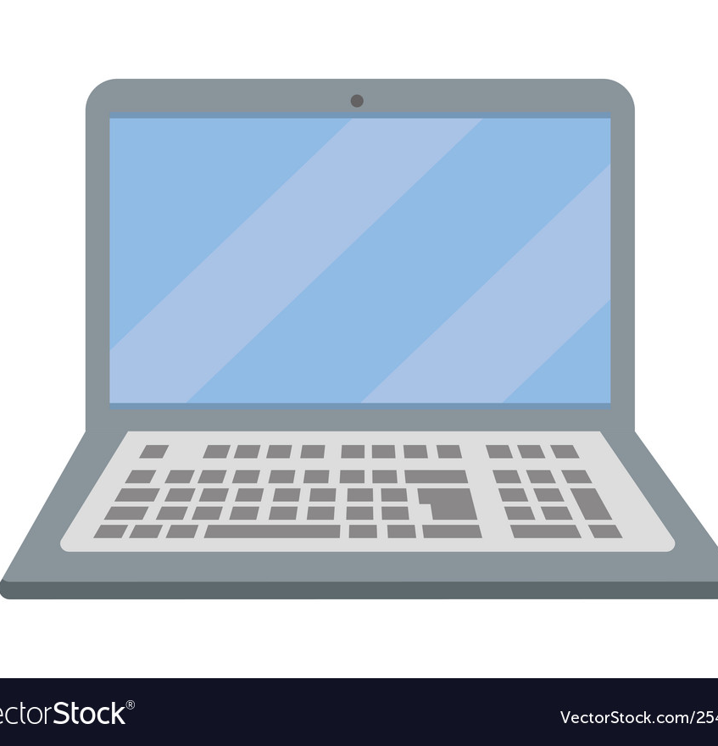
Works Cited
de Vries, D. A., Möller, A. M., Wieringa, M. S., Eigenraam, A. W., & Hamelink, K. (2017). Social Comparison as the Thief of Joy: Emotional Consequences of Viewing Strangers’ Instagram Posts. Media Psychology, 21(2), 222–245. https://doi.org/10.1080/15213269.2016.1267647
Kohler, M. T., Turner, I. N., & Webster, G. D. (2021). Social comparison and state–trait dynamics: Viewing image-conscious Instagram accounts affects college students’ mood and anxiety. Psychology of Popular Media, 10(3), 340–349. https://doi.org/10.1037/ppm0000310
Faelens, L., Hoorelbeke, K., Cambier, R., van Put, J., van de Putte, E., de Raedt, R., & Koster, E. H. (2021). The relationship between Instagram use and indicators of mental health: A systematic review. Computers in Human Behavior Reports, 4, 100121. https://doi.org/10.1016/j.chbr.2021.100121
Fagundes, L. S., Marot, T. A., & Natividade, J. C. (2020). Use of Instagram, Social Comparison, and Personality as Predictors of Self-Esteem. Psico-USF, 25(4), 711–724. https://doi.org/10.1590/1413/82712020250410
“I Look Up, I Look Down”: Assessing Antecedents and Consequents of Social Media Social Comparison. (2018). Conference Papers -- International Communication Association, 1–34.

